Slide 1
Presentation
Group-F
The Law of demand
and its existence

Slide 2
Green University of Bangladesh
Fardin Amin Arpon 20100243
Ajmie Tabassum 191002279
Md Shamiul Hossain 191002015
Abu Arefin Aroop 202002007

Slide 3
. TABLE OF CONTENTS .
01
03
04
02
Conventional law of demand
The law of demand with demand function
Exceptional law of demand
Schedule and graph
05
Thank the audience and
invite questions

Slide 4
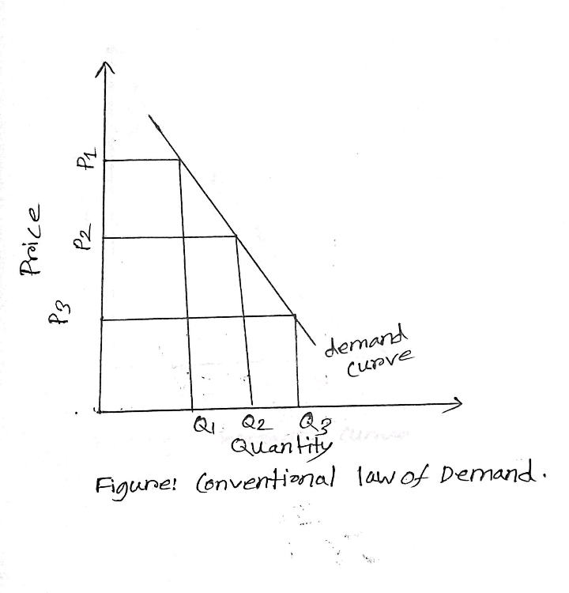
Conventional law of demand
Description
Simple Explanation of the Law of Demand
Importance of law of Demand

Slide 5
Exceptional Law of Demand
Geffen Goods
Veblen Goods
The expectation of Price Change
Necessary Goods and Services
Change in Income

Slide 6
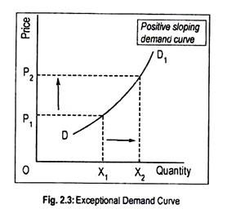
Graph of exception in law of demand

Slide 7
. Demand Function .
Definition:
Demand function is what describes a relationship between one variable and its determinants.
The demand function can be expressed as follows:
Dx = f (Px)
Where, Dx= dependent variable
Px = independent variable

Slide 8
. Types of Demand Function .
Linear Demand Function
Non-Linear Demand Function
Multivariate or Dynamic Demand Function
Necessary Goods and Services
Change in Income

Slide 9
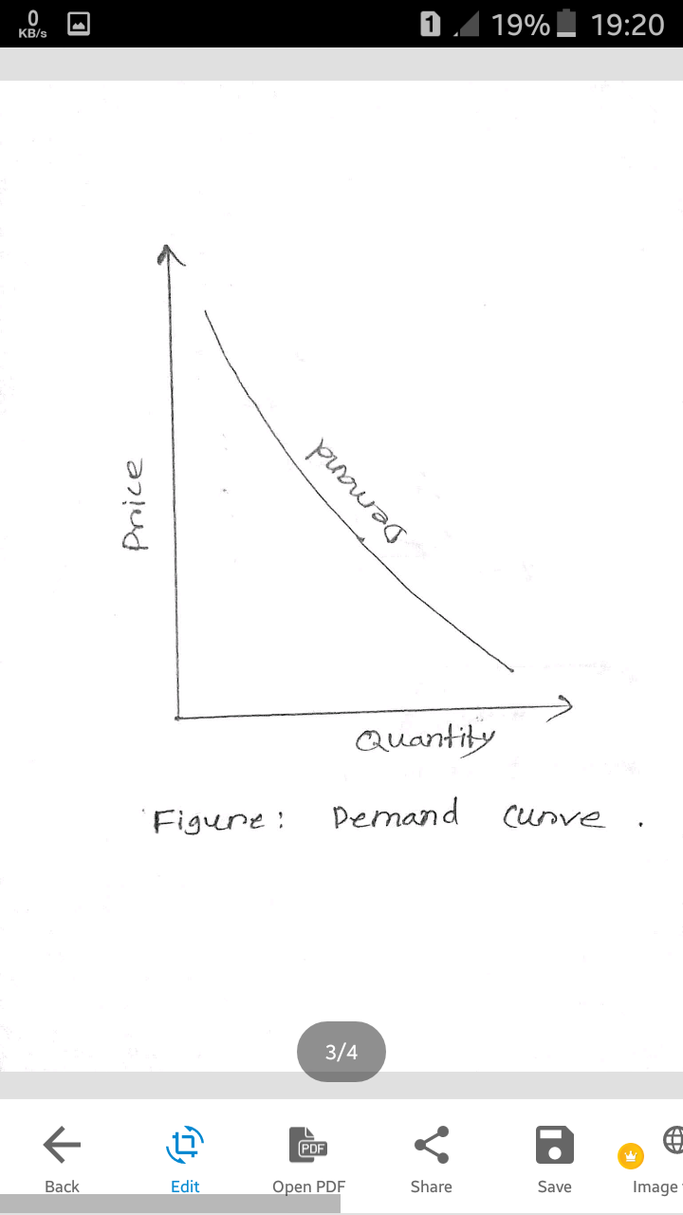
Prove of Law of Demand with Schedule and graph
Individual Demand Schedule
Demand Curve
Market Demand Schedule

Slide 10
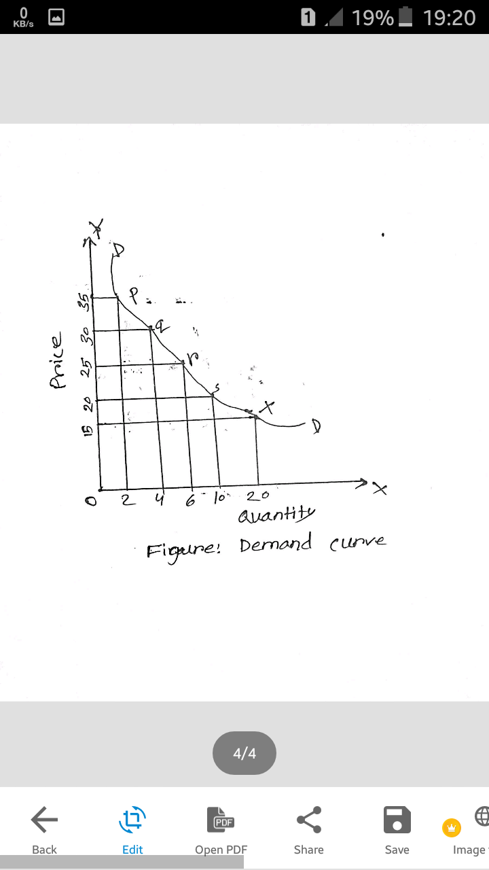
Demand schedule and graph Chart Explanation
Price of Product X (taka) | Quantity demand (kg)
15 | 20
20 | 10
25 | 6
30 | 4
35 | 2

Slide 11

Q&A Discussion .
Invite for ask question
Discussion
Q&A

Slide 12
Thank you……

